Slide 1
Employee Management System - Harish Kumar L

Slide 2
I have implemented the following features in this project:
List Employee Feature
Add Employee Feature
Update Employee Feature
Delete Employee Feature
Pagination Feature
Login Feature
Registration Feature
Logout Feature

Slide 3
ABSTRACT
Employee Management System is a distributed application, developed to maintain the details of employees working in any organization.
The EMS has been developed to override the problems prevailing in the practicing manual system.
It maintains the information about the personal and official details of the employees.
This project aims to simplify the task of maintaining records of the employees of Company.
To develop an well-designed database to store employee information.
The objective of this project is to provide a comprehensive approach towards the management of employee information.

Slide 4
ADVANTAGES
Provide computerized system for maintaining records.
More efficient & reliable.
Less time consuming and easy to use.
Huge data storage with less computer memory.
Avoid Human errors & efforts for Maintaining daily data.
Avoid Data manipulations.
Also avoids Data inconsistency & redundancy.

Slide 5
SYSTEM REQUIREMENTS
Software Requirements
Spring Tool Suit
JDK (Java Development Kit)
MY SQL
Hardware Requirements
Processor : AMB Ryzen 2.1Hz or higher
RAM : 4GB or more
Hard Disk : 128MB or more

Slide 6
TECHNOLOGIES USED
Advance JAVA - For Internal Coding
HTML / CSS - For Designing Purpose (Front End)
Maven Dependencies - Without this we can’t able to RUN the project
MY SQL - I used MYSQL Database (Back End)
Bootstrap - For makes responsive web design a reality
Thyme leaf - Used to create a Stylish template
Spring Boot (STS) - Spring Boot provides inbuilt server

Slide 7
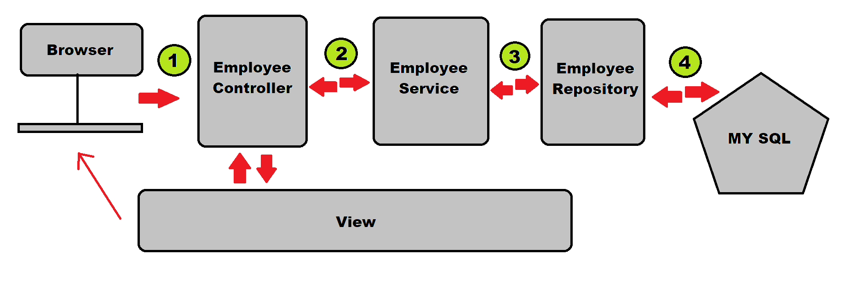
PROJECT FLOW

Slide 8
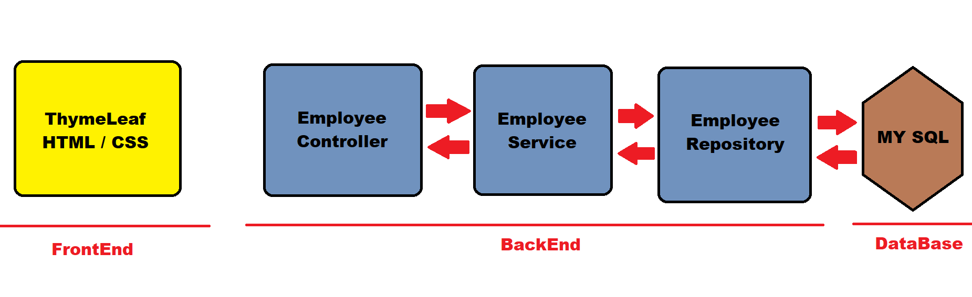
APPLICATION ARCHITECTURE

Slide 9
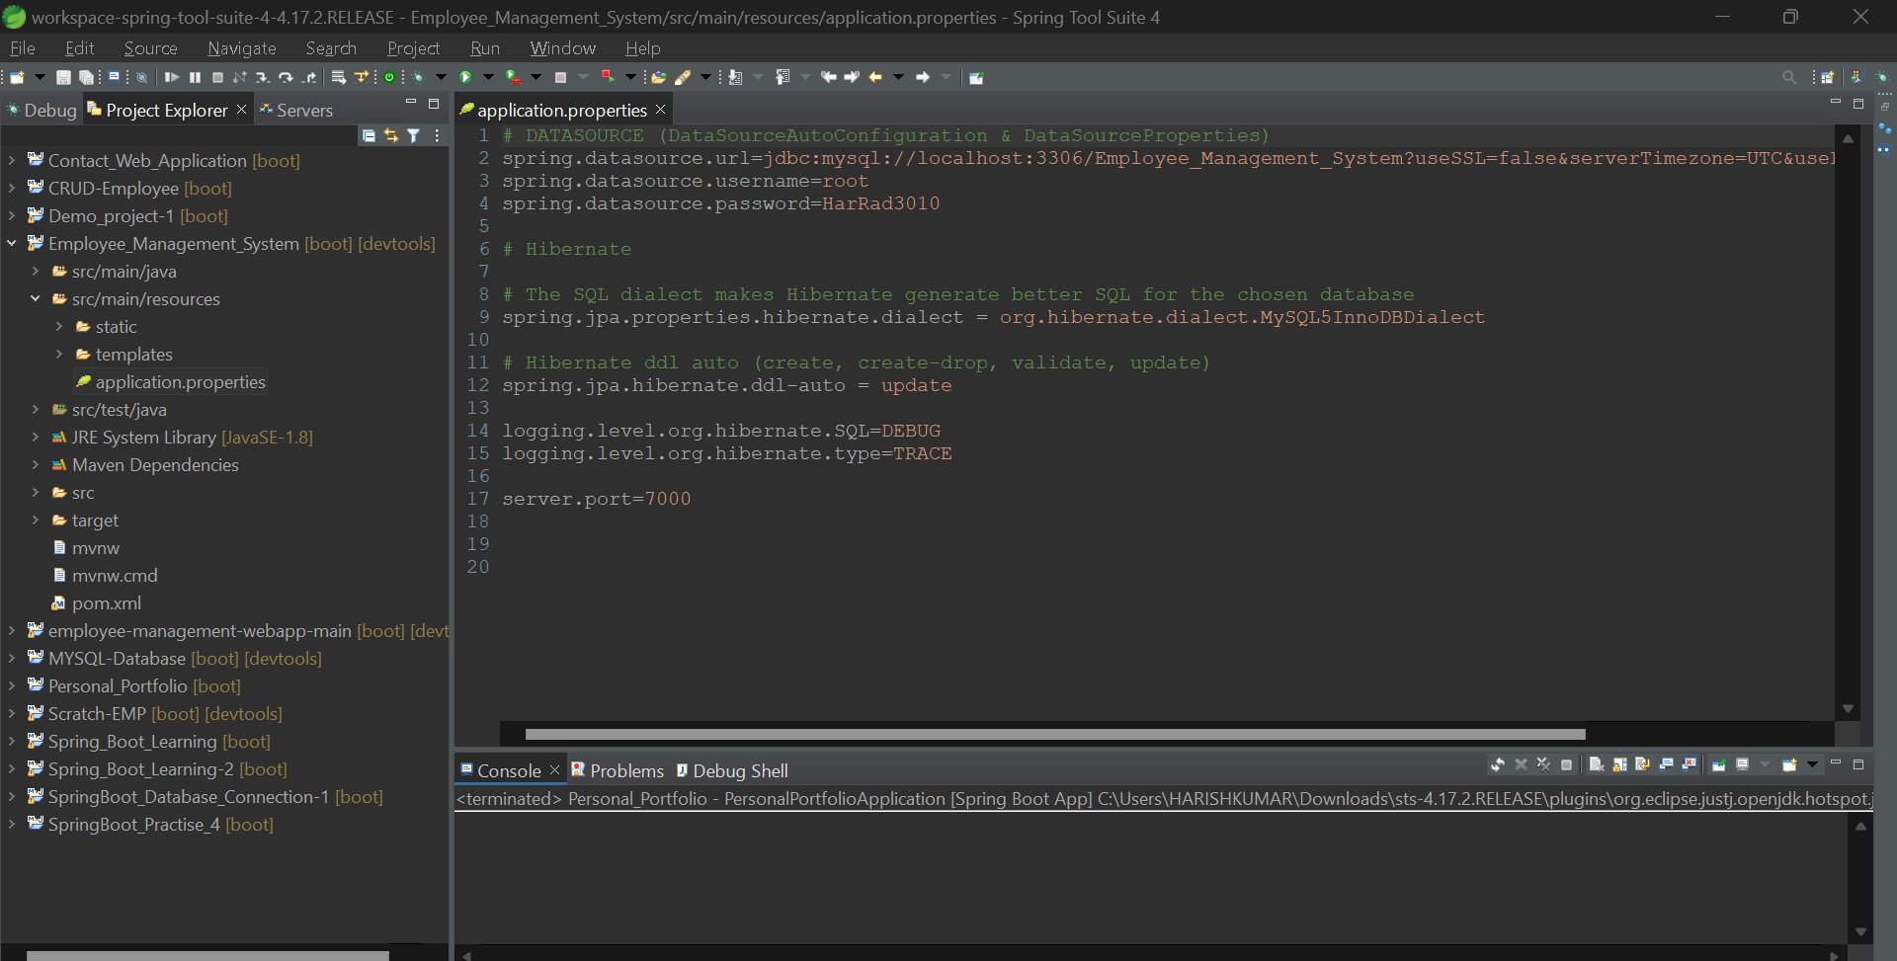
APPLICATION PROPERTIES

Slide 10
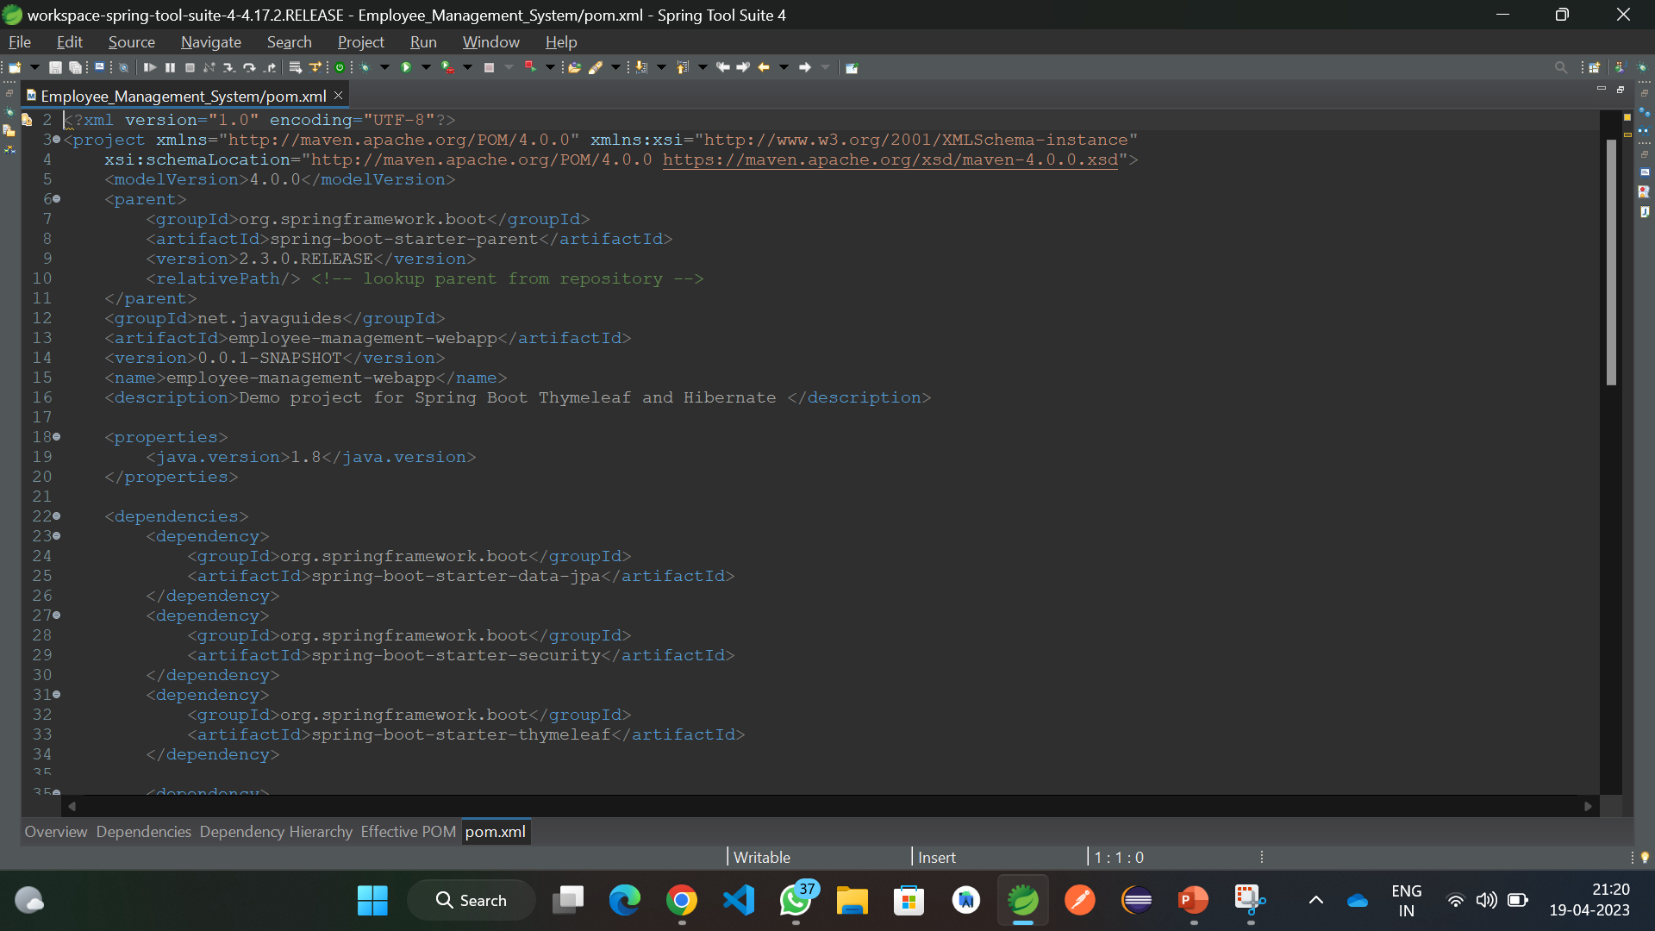
POM.xml

Slide 11
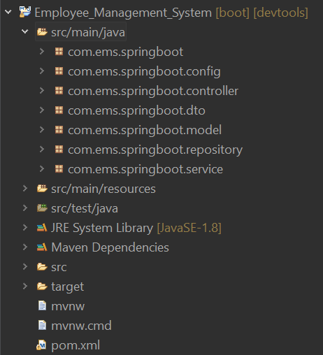
PROJECT STRUCTURE

Slide 12
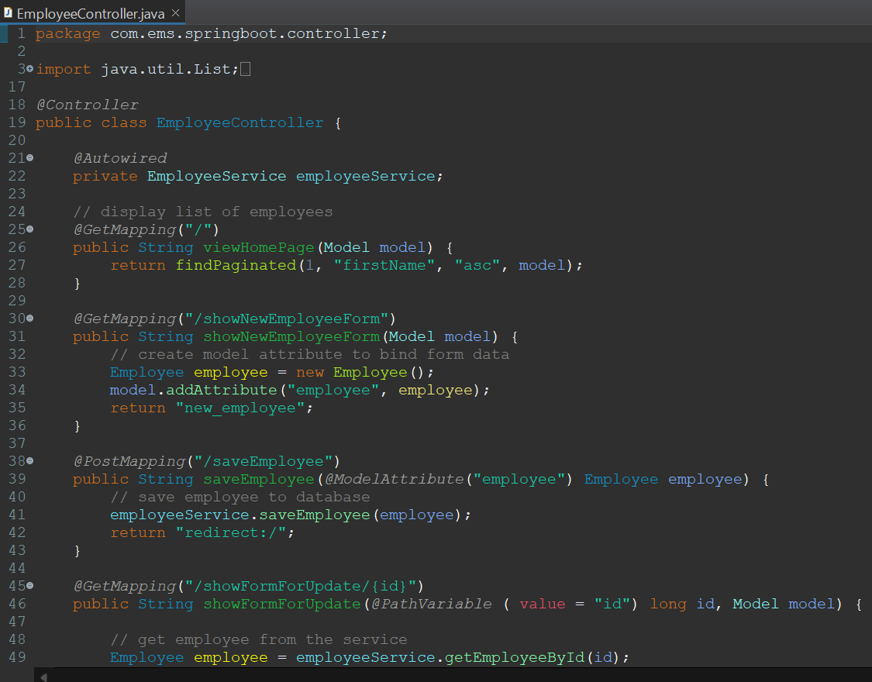
Controller
Employee Controller

Slide 13
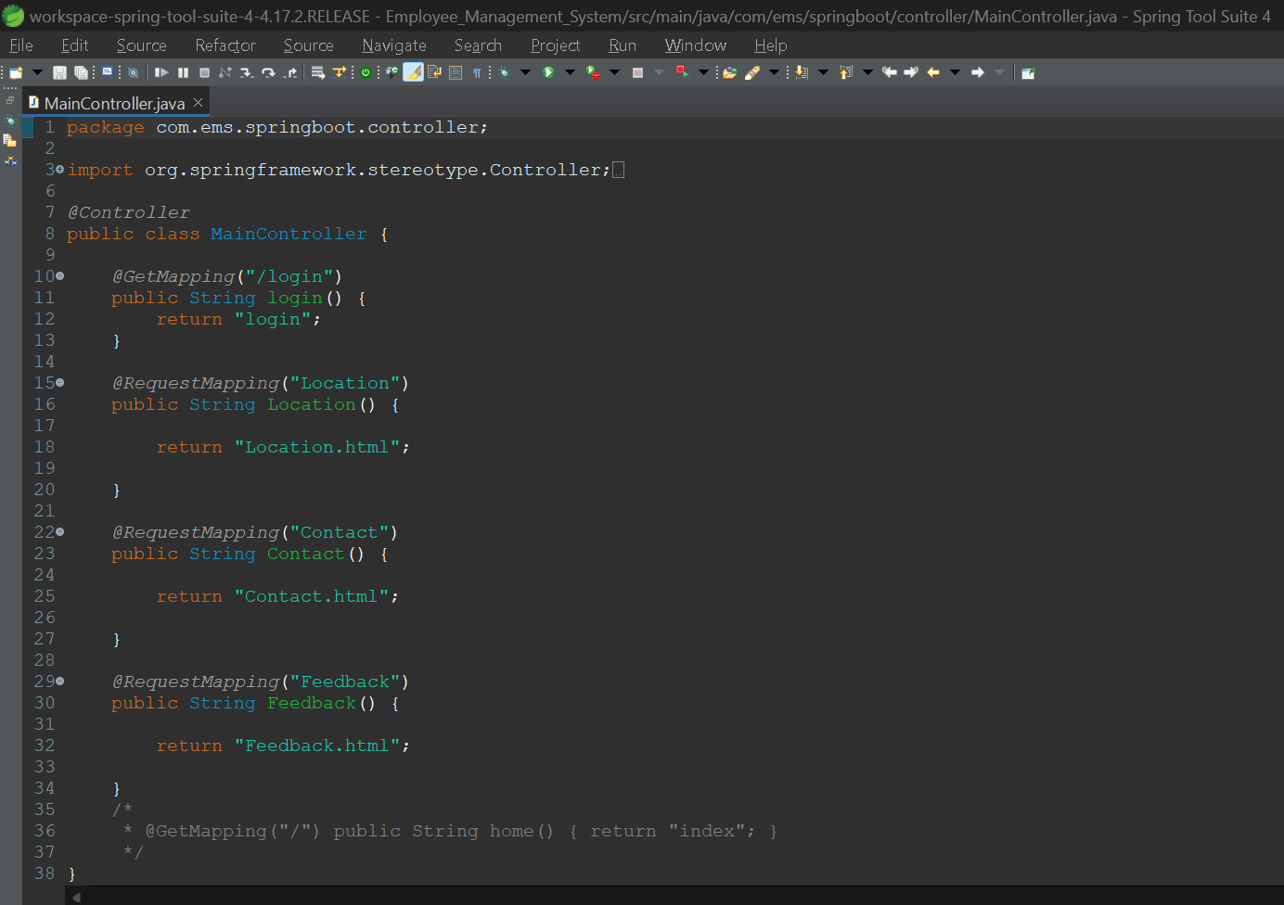
Controller
Main Controller

Slide 14
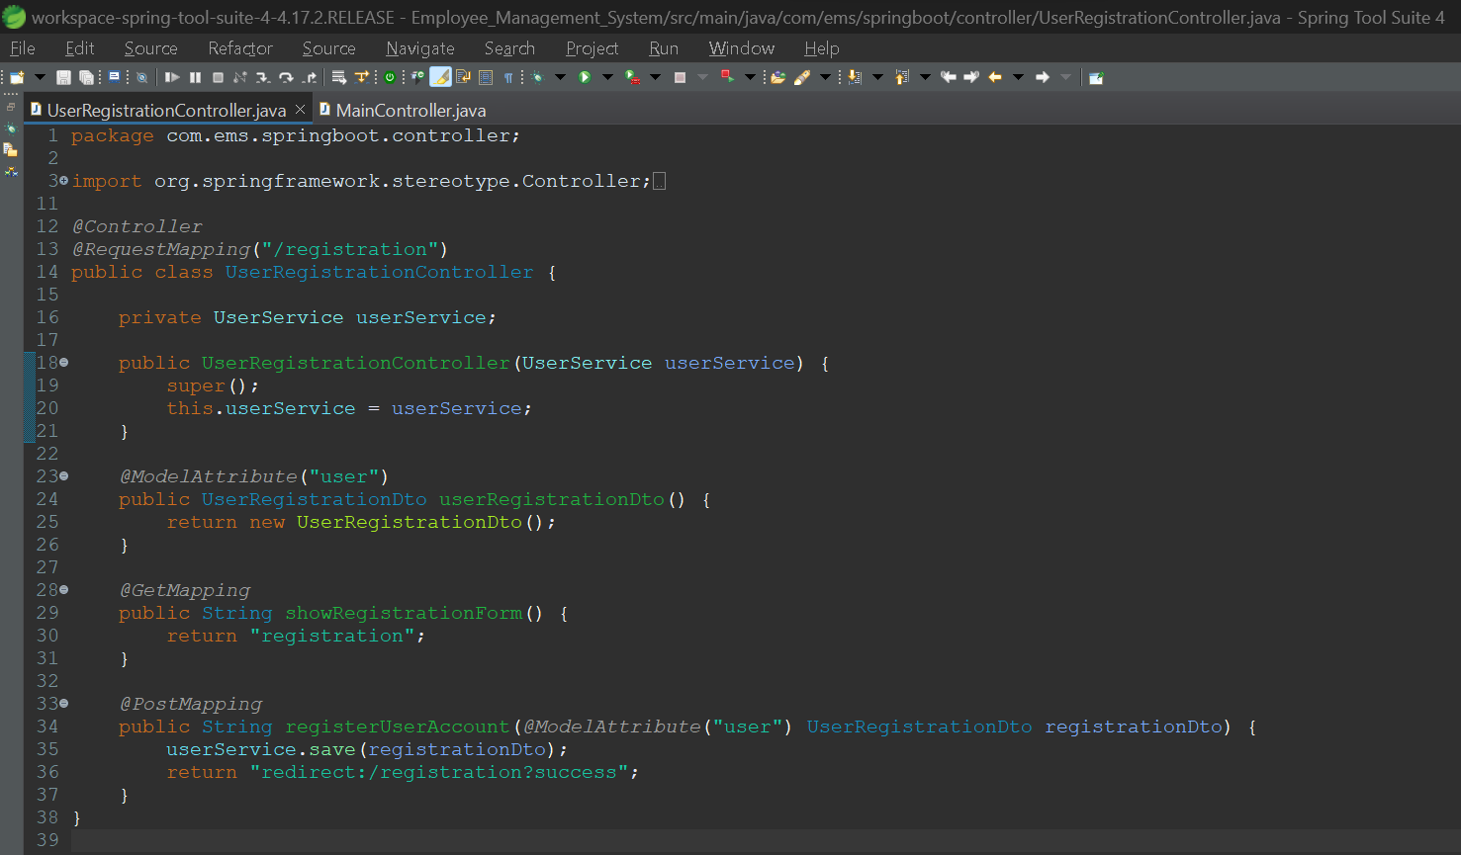
Controller
User Registration Controller

Slide 15
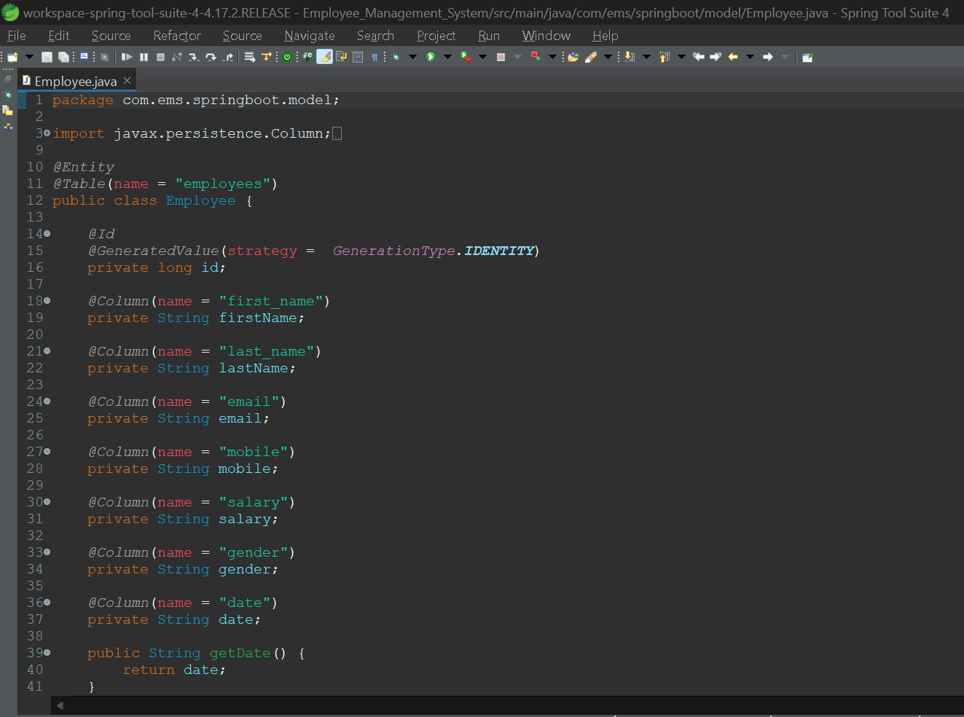
Model
Employee Model

Slide 16
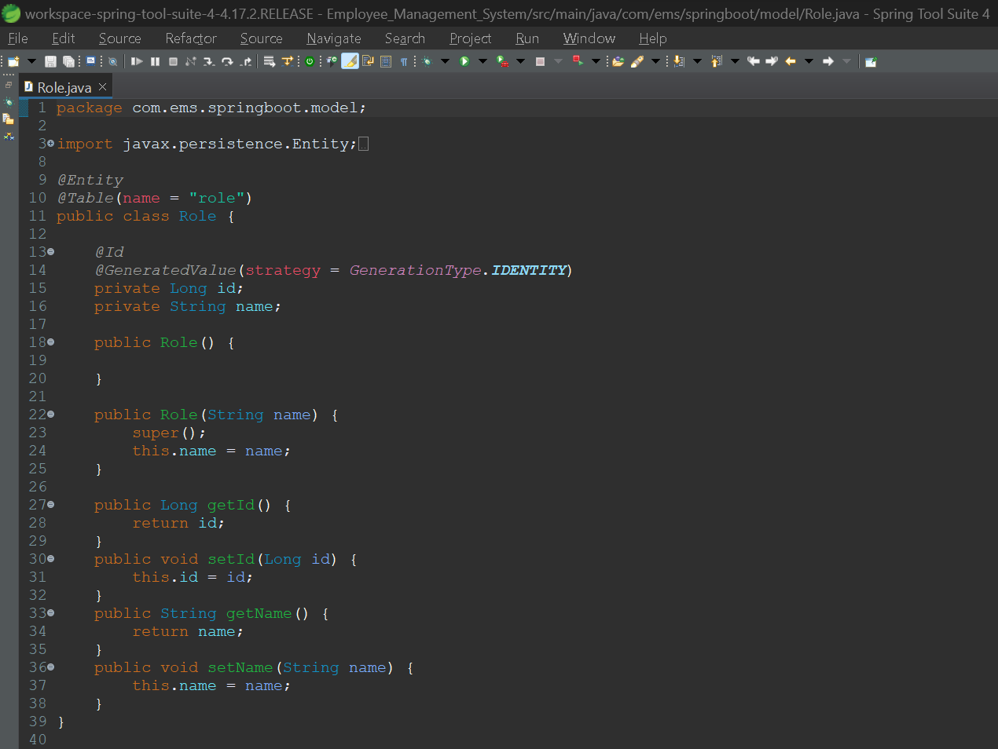
Model
Role - Model

Slide 17
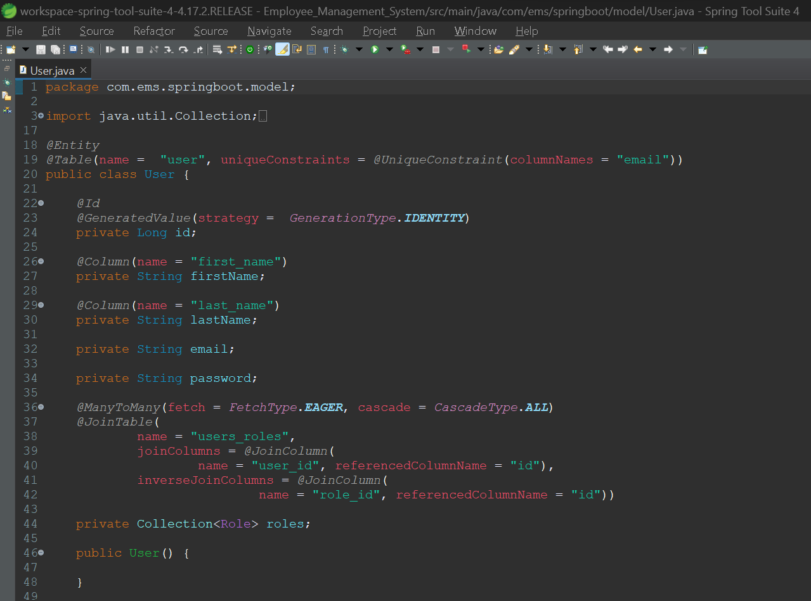
Model
User - Model

Slide 18
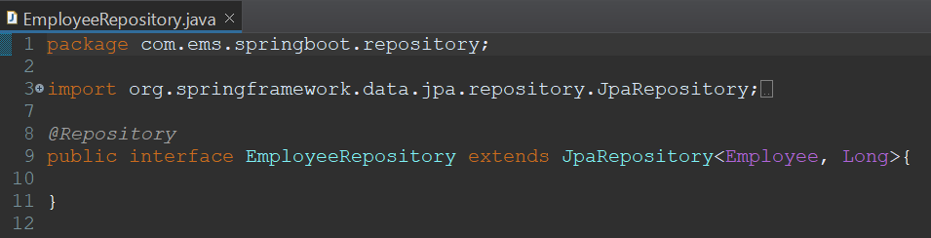
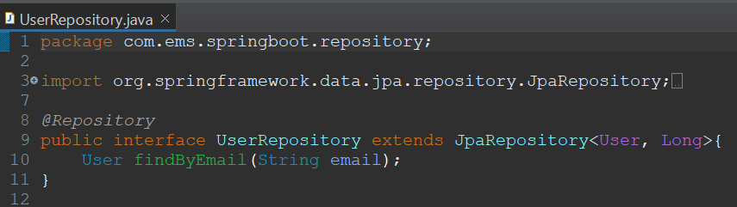
Repository
Employee Repository
User Repository

Slide 19
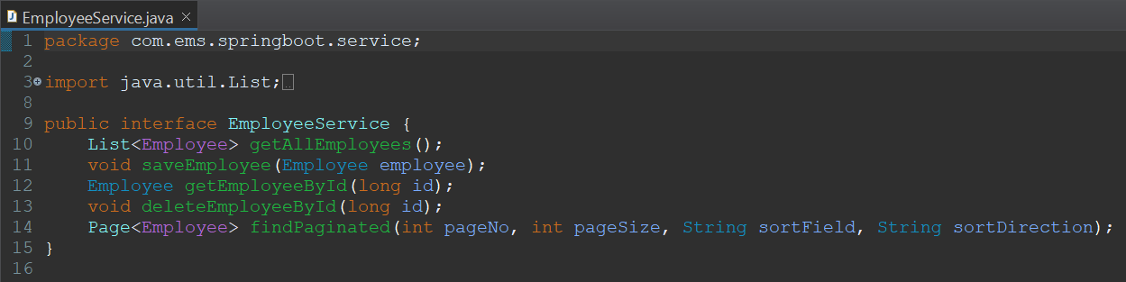
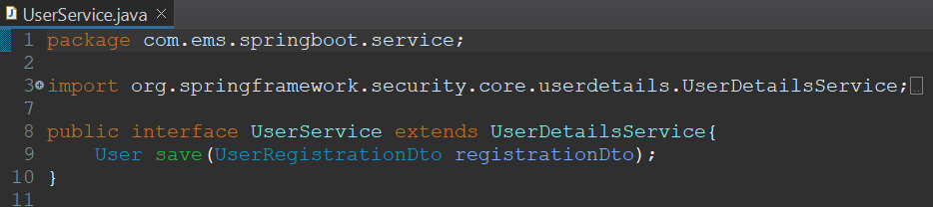
Service
Employee Service
User Service

Slide 20
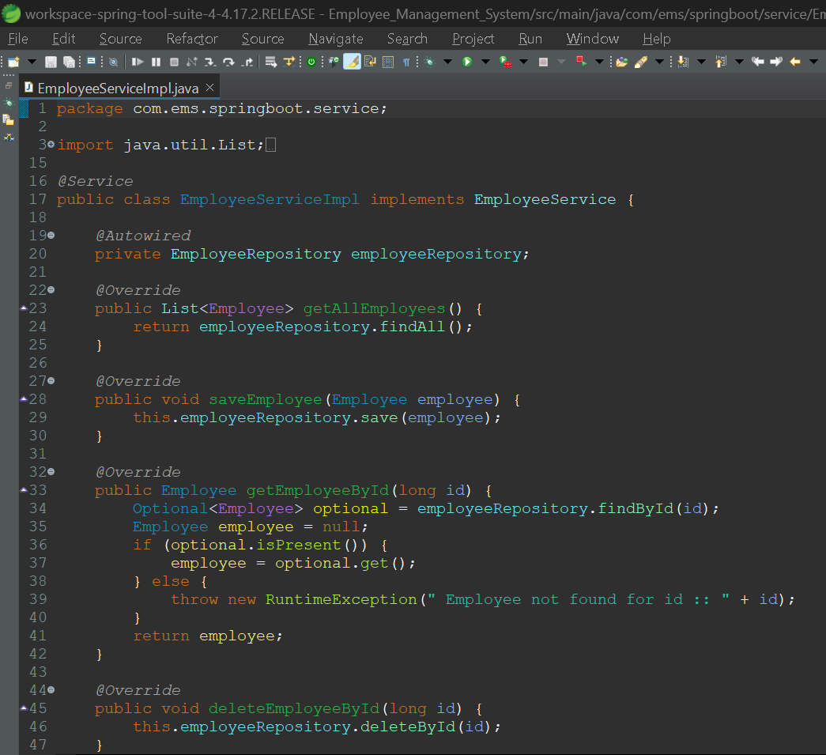
Service
Employee Service Implementation

Slide 21
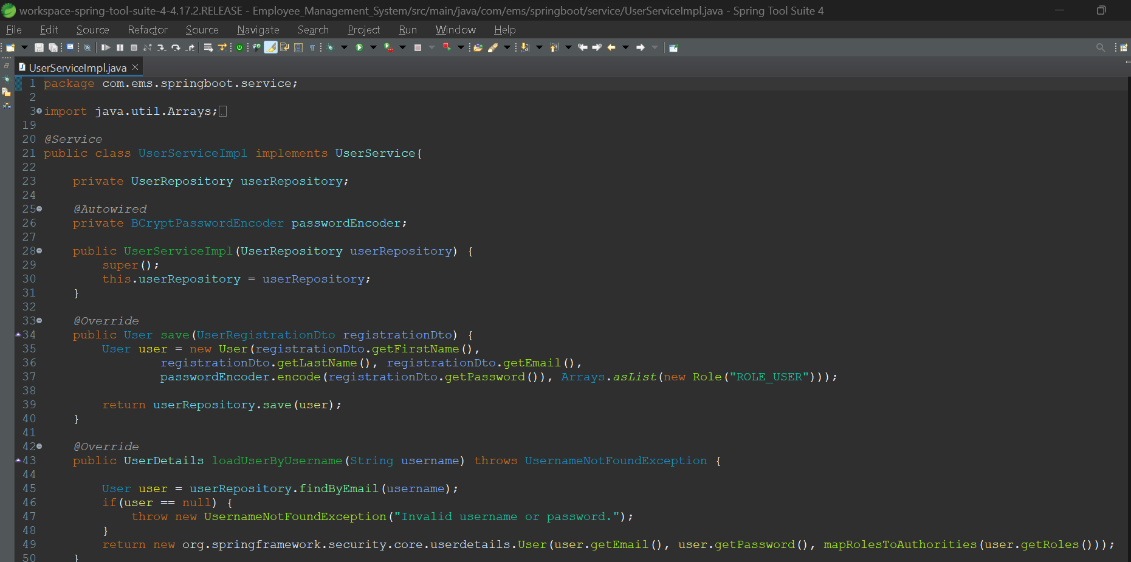
Service
User Service Implementation

Slide 22
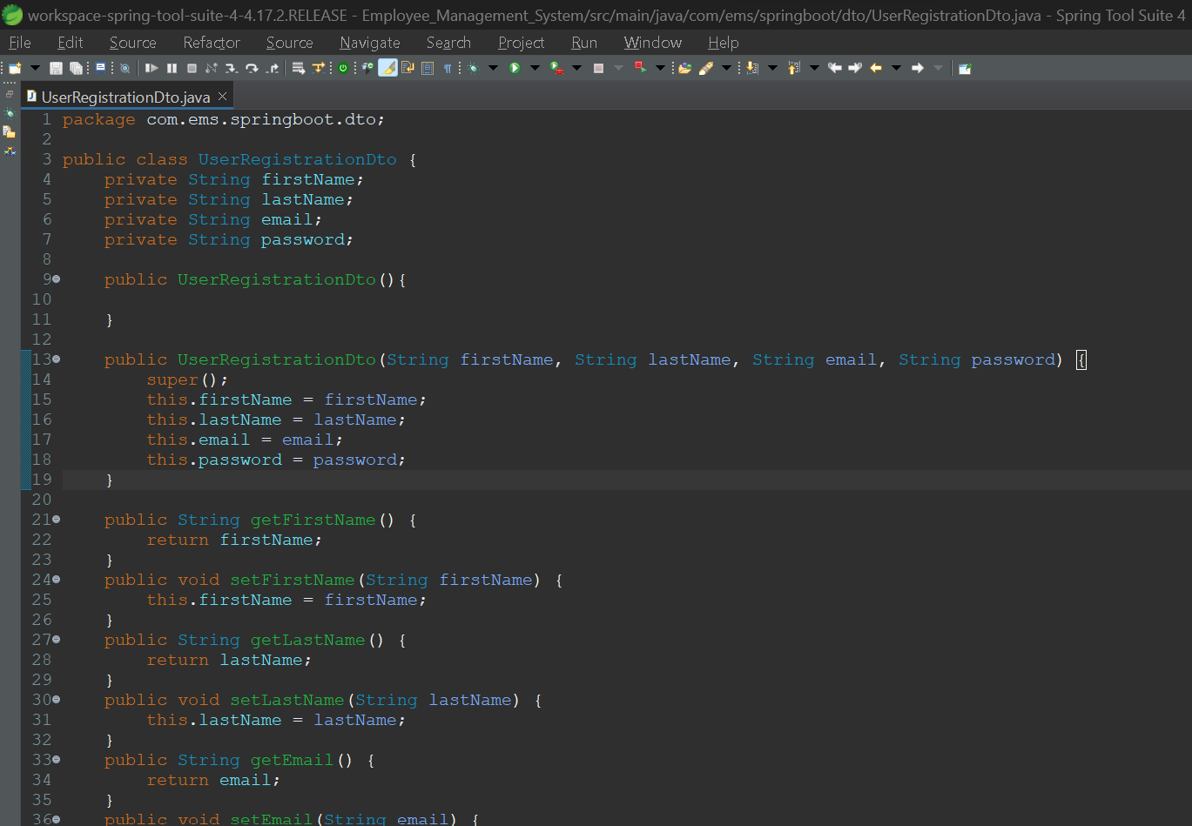
DTO
User Registration

Slide 23
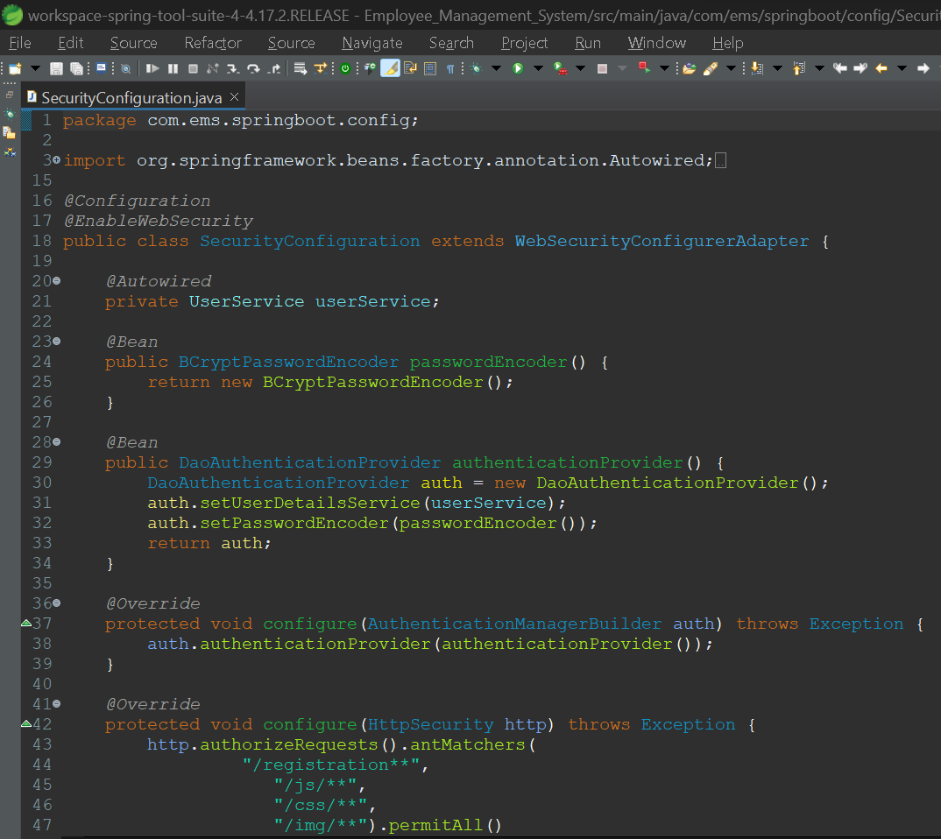
Security
Security Configuration

